Slide 1
Chapter 8
Stored Procedures

Slide 2
Review
Review of View and Cursor
A view is an alternate way of looking at data from one or more tables in the database. A view is a virtual table usually created as a result of query execution.
A view acts as a filter on the table addressed in the query.
The CREATE VIEW statement is used to create a view.
The DROP VIEW statement is used to delete a view.
Cursor is a database object used by applications to manipulate data by rows rather than sets. Using cursors, multiple operations can be performed row by row against a result set with or without returning to the original table.

Slide 3
Review Contd…
A cursor is created using DECLARE statement. First a cursor is declared or created in the memory. Then it is opened.
OPEN statement is used to open the cursor. Retrieving records from a cursor is called fetching. A user can retrieve only one record at a time.
FETCH command is used for reading the records from the cursor.
By default, a cursor is forward only. It can fetch the records from the first record to the last record. It cannot directly fetch the first or last row in the table.

Slide 4
Review Contd…
When a cursor is temporarily not required, it can be closed using the CLOSE statement.
Once the cursor is used, its reference should be removed using the DEALLOCATE statement.

Slide 5
Objectives
Define stored procedures.
List the benefits of stored procedures.
Discuss types of stored procedures.
Explain the categories of system stored procedures.
Explain process of creating, modifying and executing user-defined stored procedures.
Use parameters in stored procedures.
Choose appropriate recompile options.
Explain the process of handling error messages in stored procedures.

Slide 6
Stored Procedures
Pre-compiled collection of T-SQL statements stored with a name
Written by database developers or DBAs
Used to perform administrative tasks, or apply complex business rules
Contain DML statements

Slide 7
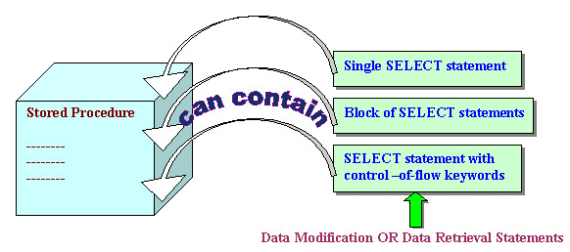
Stored Procedures Contd…

Slide 8
Benefits of Stored
Procedures
Increased execution speed
Faster access to data
Modular programming
Consistency
Enhanced security

Slide 9
Types of Stored
Procedures
System stored procedures (can only be executed)
User-defined stored procedures (can be created and executed)

Slide 10
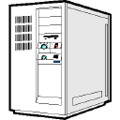
Categories of System
Stored Procedures
SQL Mail
Catalog
Extended
SQL Server
Query Agent
Replication
Distributed
Query
System stored
procedures
System
Cursor
Security

Slide 11
Examples of System Stored Procedures
sp_databases
sp_stop_job
sp_server_info
sp_password
sp_stored_procedures
System stored
procedures
sp_configure
sp_tables
sp_help
sp_start_job
sp_helptext

Slide 12
User-defined Stored
Procedures
Created by users in the current database using the CREATE PROCEDURE statement
Database owner has default permission to use the CREATE PROCEDURE statement
Syntax:
CREATE PROC[EDURE] procedure_name
Example:
CREATE PROCEDURE Titles_1389 AS
PRINT ‘This code displays the titles for publisher 1389’
SELECT * FROM titles WHERE pub_id = ‘1389’

Slide 13
Guidelines for User-defined
Stored Procedures
The name must follow the naming rules for identifiers.
All database objects can be created within a stored procedure, except defaults, rules, triggers, procedures, and views. The created object can be referenced within the procedure once it is created.
Stored procedures can reference temporary tables.
Procedures called within a stored procedure have access to all objects created in the calling procedure.
2100 parameters can be used in a stored procedure.

Slide 14
Guidelines for User-defined
Stored Procedures Contd…
We can create as many local variables in a stored procedure as the memory can accommodate.
The maximum size of a stored procedure is 128 MB.

Slide 15
Executing User-defined
Stored Procedures
The EXECUTE statement is used to run user-defined stored procedures.
Syntax:
EXEC[UTE] procedure_name
Example:
EXECUTE Titles_1389

Slide 16
Using Parameters in
Stored Procedures - I
Parameters can be used to input or output values from the stored procedure.
Syntax:
CREATE PROCEDURE procedure_name
@Parameter_name data_type
AS
:

Slide 17
Using Parameters in
Stored Procedures - II
Example creation:
CREATE PROCEDURE Titles_Pub
@v_pubid char(4)
AS
SELECT * FROM titles WHERE pub_id = @v_pubid
Example execution:
EXECUTE Titles_Pub ‘0877’

Slide 18
Re-compiling Stored
Procedures
Stored procedures have to be recompiled to reflect changes made to indexes.
There are three ways to recompile procedures:
  Using the sp_recompile system stored procedure
  Specifying WITH RECOMPILE with CREATE PROCEDURE
  Specifying WITH RECOMPILE with EXECUTE

Slide 19
Modifying Stored
Procedures
ALTER PROCEDURE statement is used to modify a stored procedure
Syntax is similar to CREATE PROCEDURE
Altering retains user permissions

Slide 20
Handling Error Messages
Return codes or the RAISERROR statement can be used to inform the user of errors
Return code in stored procedures returns integer values
RAISERROR statement logs errors and assigns severity levels

Slide 21
Return Codes
Return codes return only integer values. By default, the return code value is 0.
Return codes must return their values to a variable.
Syntax:
DECLARE @return_variable_name data_type
EXECUTE @return_variable_name = procedure_name

Slide 22
Return Codes Contd…
Example:
ALTER PROCEDURE Titles_Pub
@v_pubid char(4)
AS
DECLARE @v_return int
SELECT @v_return=COUNT(*)
FROM titles WHERE pub_id = @v_pubid
IF @v_return>0
SELECT * FROM titles WHERE pub_id = @v_pubid
ELSE
RETURN @v_return+1

Slide 23
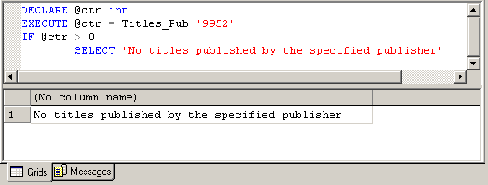
Return Codes Contd…

Slide 25
RAISERROR Statement
Contd…
WHILE @v_ctr > 0
BEGIN
SELECT @v_ctr * @v_ctr
SELECT @v_ctr = @v_ctr – 1
IF @v_ctr = 2
BEGIN
RAISERROR('Counter has fallen
below 3', 1, 2)
BREAK
END
END

Slide 26
RAISERROR Statement
Contd…
Output:
25
16
9
Contents of message pane:
(1 row(s) affected)
(1 row(s) affected)
(1 row(s) affected)
Msg 50000, Level 1, State 50000
Counter has fallen below 3

Slide 27
Summary
A stored procedure is a precompiled group of SQL statements.
Database developers or administrators write stored procedures to run commonly performed administrative tasks, or to apply complex business rules. The stored procedure contains data manipulation or data retrieval statements.
Stored procedures accelerate query execution, provide faster access to data, aid modular programming, maintain consistency, and enhance security.

Slide 28
Summary Contd…
There are two types of stored procedures:
  System stored procedures that offer mechanisms for database administration, and updating tables.
  User-defined stored procedures.
The CREATE PROCEDURE statement is used to create a user-defined stored procedure.
The EXECUTE statement is used to run the stored procedure.
Parameters can be used to input or output values from the stored procedure.

Slide 29
Summary Contd…
There are three ways to recompile stored procedures:
  Using sp_recompile system stored procedure
  Specifying WITH RECOMPILE with CREATE PROCEDURE
  Specifying WITH RECOMPILE with EXECUTE
The ALTER PROCEDURE statement is used to modify a stored procedure.
Return codes or the RAISERROR statement are used to inform users of errors.

